Slide 1
Submitted by Shincy Johny MCA B Batch
Android based surplus food management app

Slide 2
Objective
Everyday there may be a chance to waste foods in hotels restuarants etc. We use this app for reducing the food balance problem through android application. In this project we deal with balance food of hotel.

Slide 3
Description
This android-based surplus food Management app can assist in collecting the leftover food from hotels & restaurants to distribute among those in need..Hotel add their details. So they can login and enter their food details in app. Then add simple notification .Then the orphanage can login & can gather the details of the hotel.And can view the donation page and can accept it. Admin have the entire control of the system.Admin can approve or reject the verified hotels.Admin can add the details of food inspector,carriers,and orphanages or old-age homes or poor people.Admin view complaints and reply for that.Admin can add common notifications.Food inspector verify the registered hotels and admin allot the inspectors for verifying hotel.Food inspector can view the complaint from orphanage .Orphanage can also send complaint to admin and admin may suspend or warn the hotels.The hotels can hold an account in this app & whenever there is food extra he can login and enter the details of food.Then admin assign a carrier for distributing the food. After retrieving the details the carrier can collect food from the hotels and can redistribute to the orphanages or others.

Slide 4
Existing System
If any hotels have extra food it will be become waste because instantly there is no way to share with anyone if they are having lots of food. Even if they want to give that extra food to any orphanage or poor people they don’t have time or don’t have an idea about that. So that we have create an application for donate that extra food to poor people like nearby orphanage or old age homes or poor people.If they have lot of food, hotel will dispose.No proper way to inform others.

Slide 5
Proposed System
In proposed system we are reduce that food wastage using that application and also handover the balance food to right people. Through this application we are recovering from food poverty. This project is helpful for reducing food waste. the extra food is added by hotel.The orphanage can view the donation of food through this app and also they can accept the necessary food.Then admin select carrier and provide to nearest orphanages or old age homes.The hotel can donate the food.

Slide 6
Modules
Login
In this module after the signup process using respective username and password we can login to this app.

Slide 7
Searching the hotel
After successful login orphanage can view the donation page of various hotel for balance food.
If any balance food is seen orphanage can accept donation.
Orphanage can send complaint to admin or inspector

Slide 8
Adding extra food
Hotel Add balance food
View & update profile

Slide 9
Collect food from hotels (Carrier)
Admin assign the carrier for delivering the balance food to orphanage.

Slide 10
Software Requirements
IDE : Android Studio
Frond end: Android,java
Back end : MySQL,PHP
Database: SQL

Slide 11
Advantages
Benefits will be both the hotels (reducing food wastage), and the orphanage/oldage home.
Keep track of balance food for restaurant

Slide 12
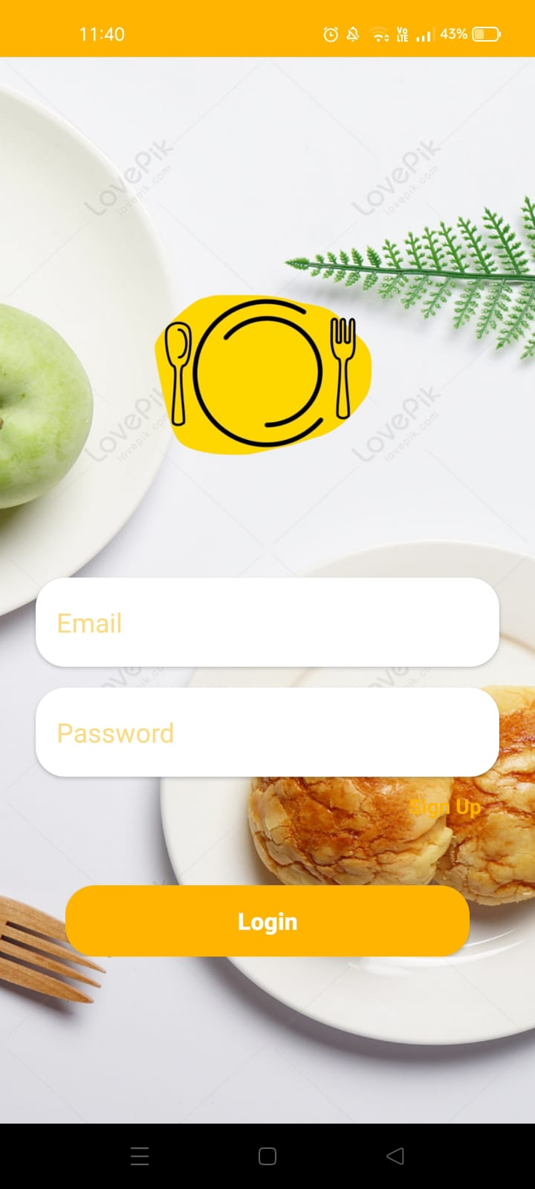
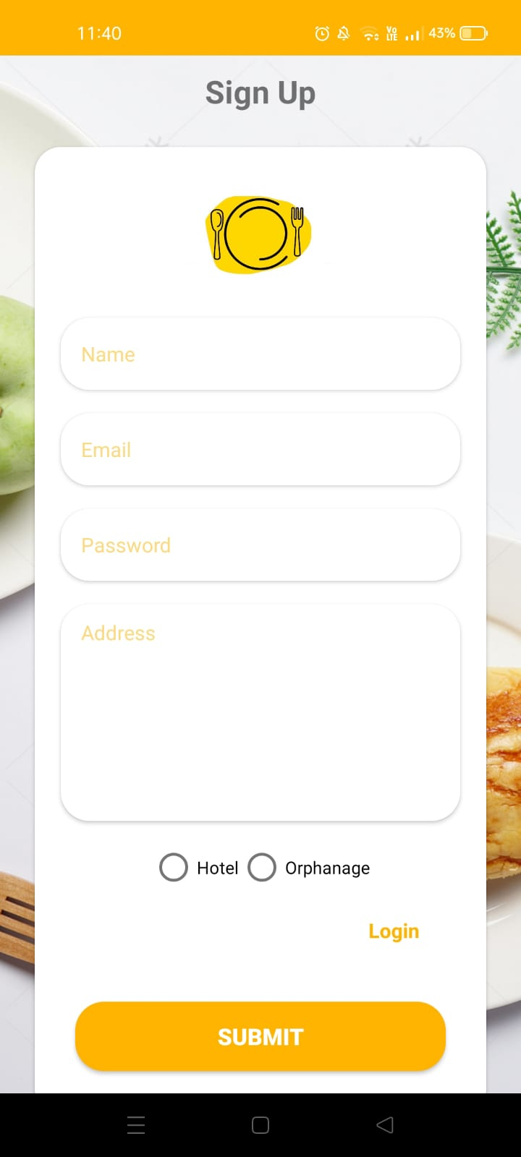
Screenshots

Slide 13
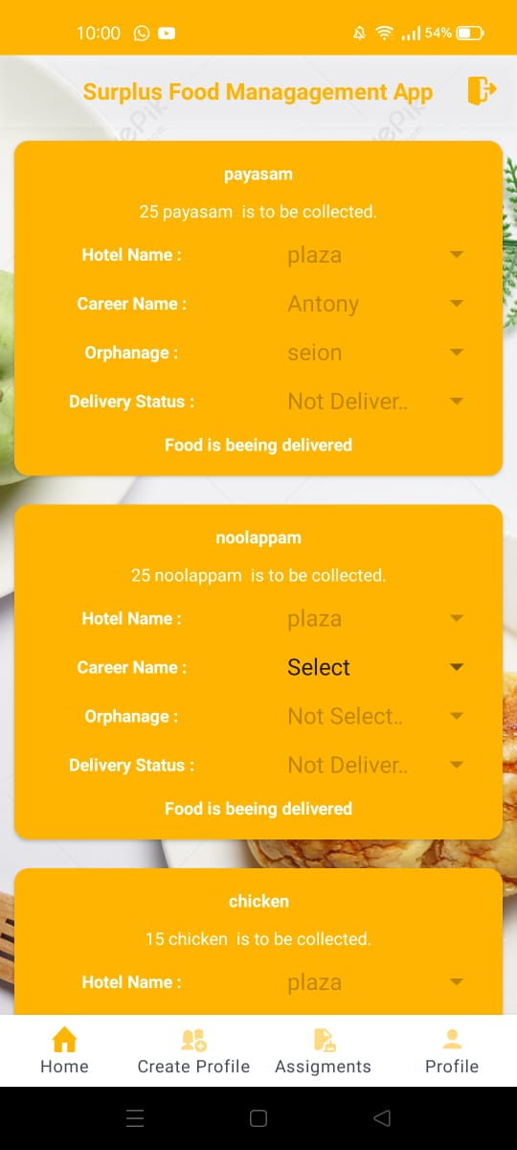
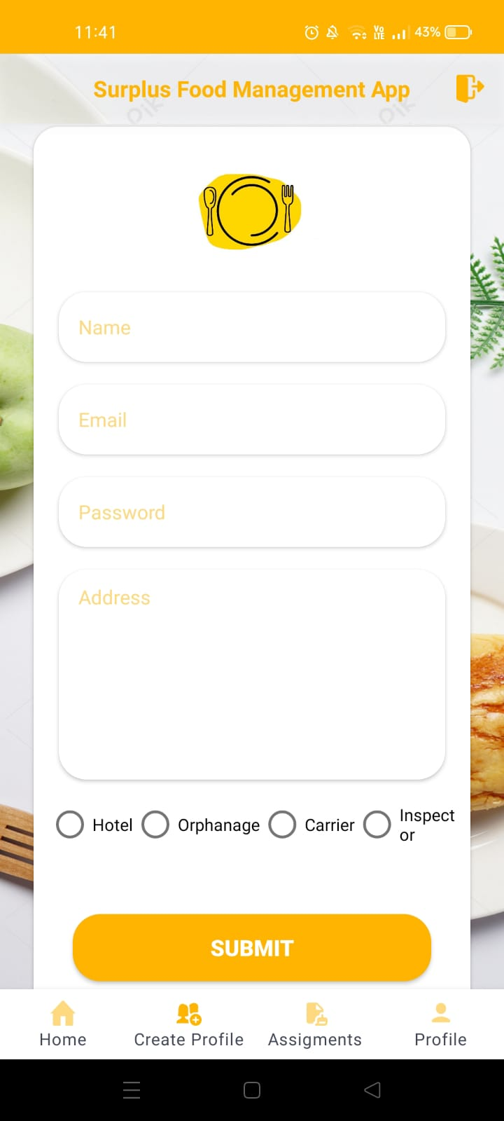

Slide 14
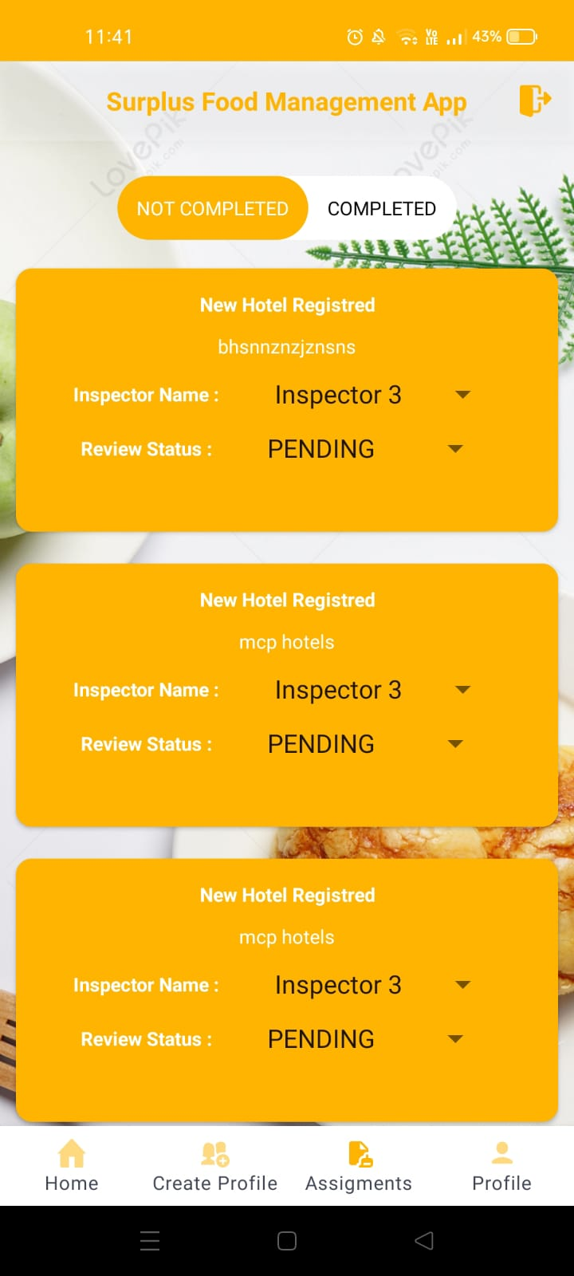
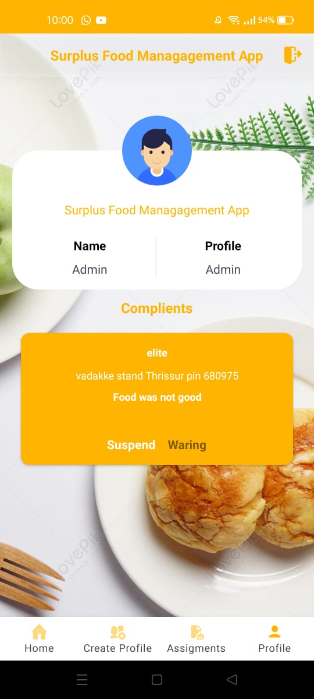

Slide 15
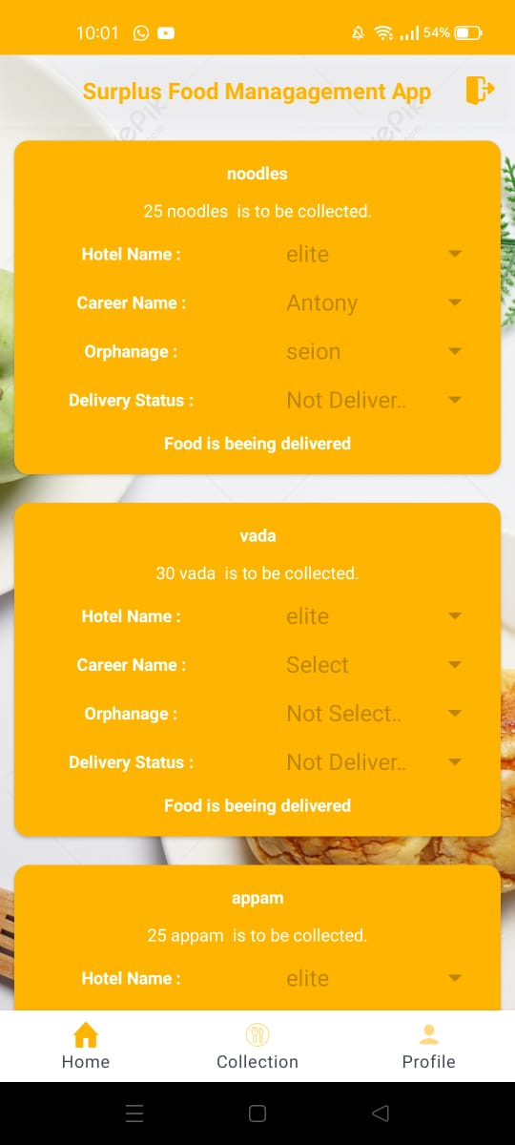
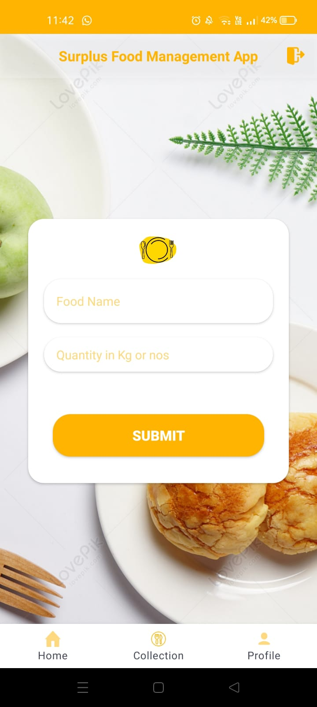
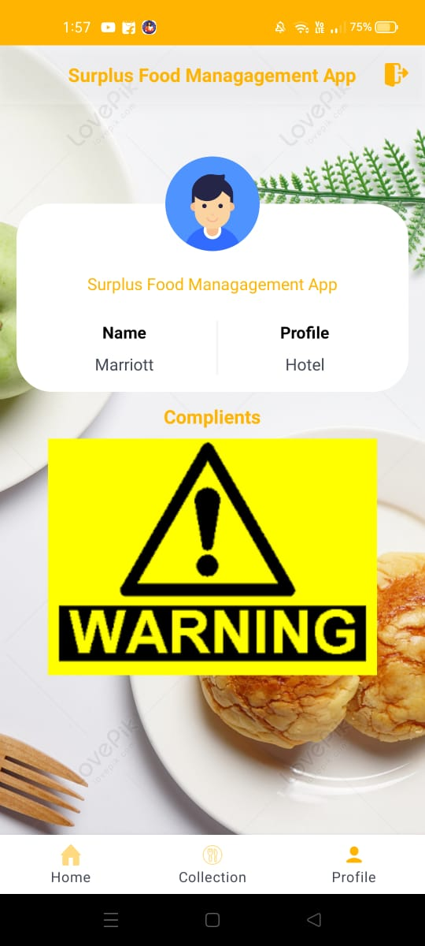
Hotel Page

Slide 16
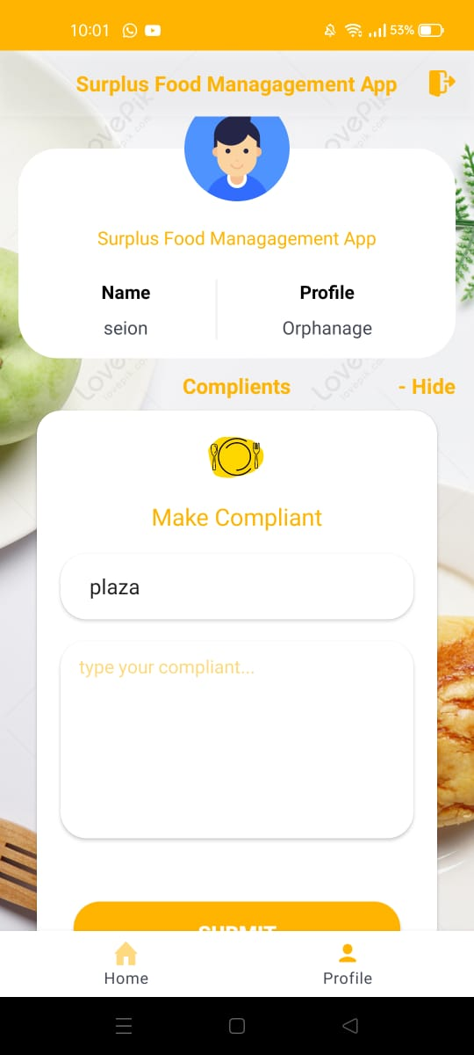
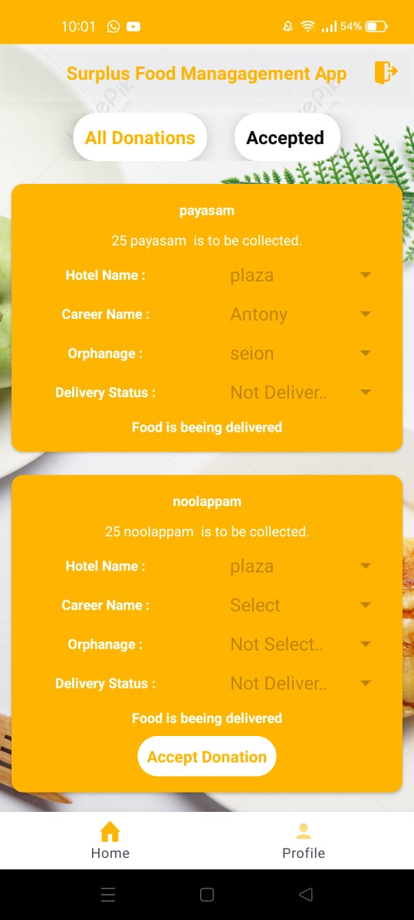
Orphanage page

Slide 17
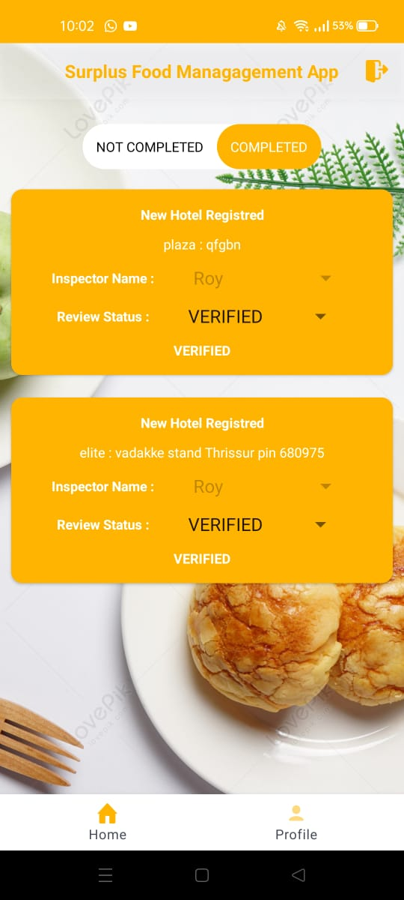
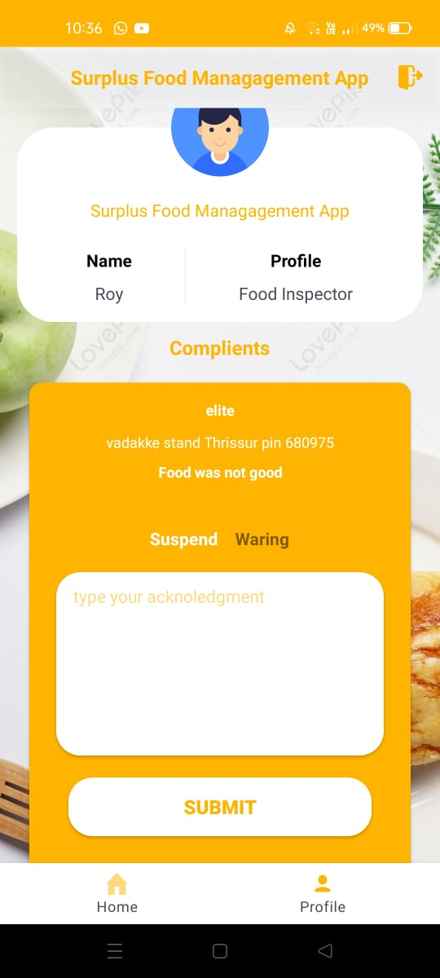
Inspector page

Slide 18
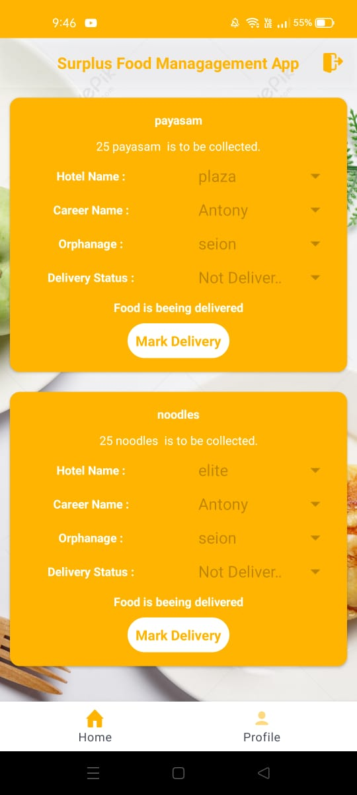
Carrier page

Slide 19
Thankyou

